Slide 1

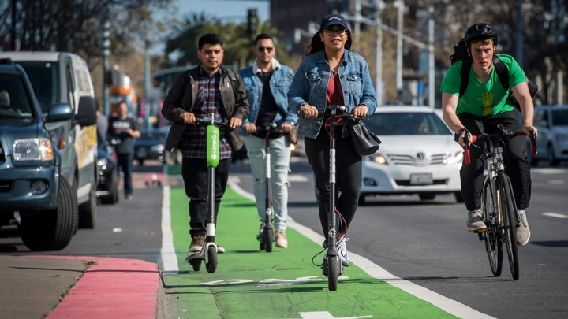
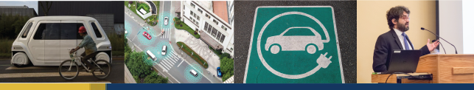
COVID-19 Impacts on Mobility:
Emerging Changes in Travel Behavior
3RFM Deep Dive, September 9, 2020
Grant Matson
Graduate Student Researcher, 3 Revolutions Future Mobility Program, UC Davis
gamatson@ucdavis.edu

Slide 2
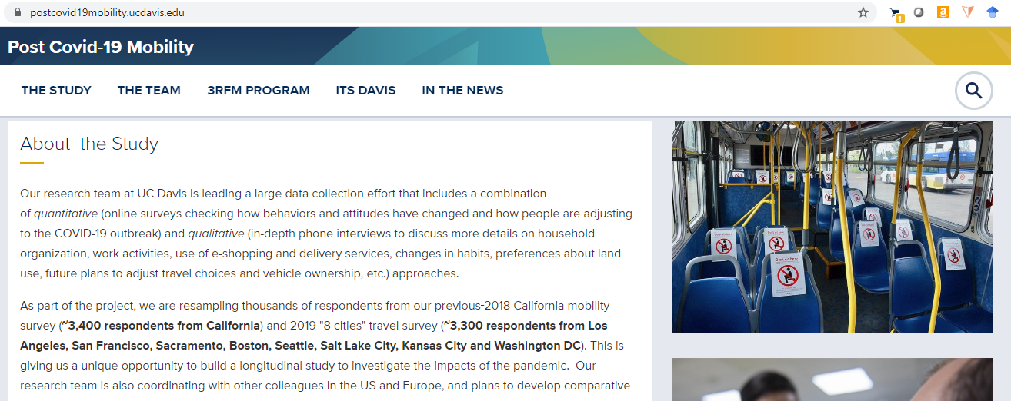
For more info on the UC Davis COVID-19 Mobility Study, please visit:
postcovid19mobility.ucdavis.edu

Slide 3
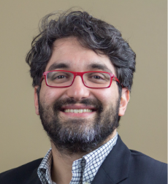
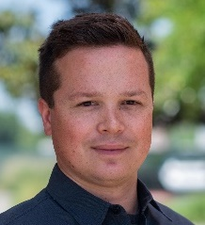
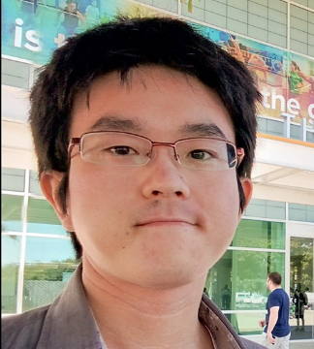
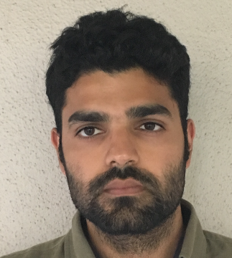
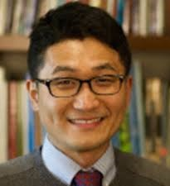
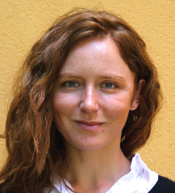
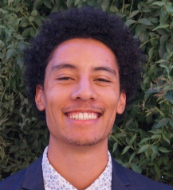
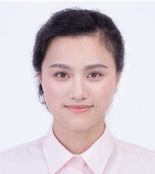
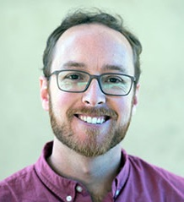
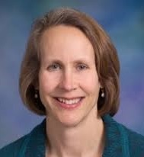
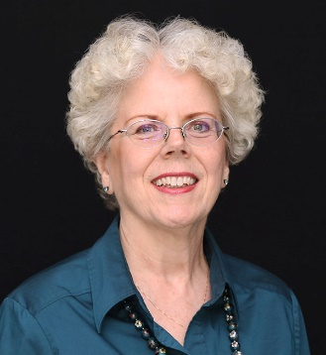
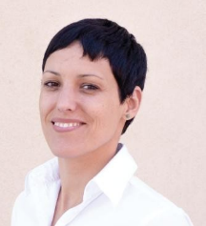
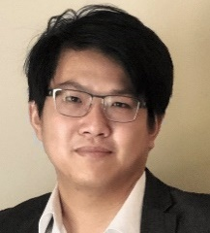
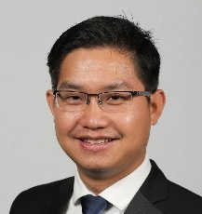
Research Team
Giovanni Circella
Director, 3RFM Program
University of California, Davis
Grant Matson
Graduate Student Researcher
University of California, Davis
Keita Makino
Graduate Student Researcher
University of California, Davis
Jai Malik
Graduate Student Researcher
University of California, Davis
Yongsung Lee
Postdoc Researcher
Georgia Institute of Technology
Junia Compostella
Graduate Student Researcher
University of California, Davis
Sean McElroy
Graduate Student Researcher
University of California, Davis
Xiatian Wu
Graduate Student Researcher
University of California, Davis
Dillon Fitch
Postdoc Researcher
University of California, Davis
Susan Handy
Professor
University of California, Davis
Pat Mokhtarian
Professor
Georgia Institute of Technology
Rosa Dominguez-Faus
Program Manager, 3RFM Program
University of California, Davis
Kailai Wang
Postdoc Researcher
University of California, Davis
Tho Le
Postdoc Researcher
University of California, Davis
With the contribution of many other colleagues at UC Davis and other partner institutions…

Slide 4
























Acknowledgements
Lew Fulton
Mollie D’Agostino
Dan Sperling
Kari Watkins
Austin Brown
Becca Kiriazes
Many other colleagues at UC Davis, other institutions and partner agencies have also contributed to this research.
Research Supported by:
Other Research Partners:
3 Revolutions Future Mobility Program Sponsors:

Slide 5
Acknowledgements
Giovanni Circella
Jai Malik
Yongsung Lee
Xiatian Wu
Sean McElroy
Keita Makino
Many other colleagues at UC Davis, other institutions and partner agencies have also contributed to this research.
Research Supported by:
3 Revolutions Future Mobility Program Sponsors:
Notes:
This is the modified version for Grant’s presentation

